Slide 1
Unlocking the Power of Data Science: Applications, Impact, and Future Trends
By: Eng Kondwani Nyirenda

Slide 2
TABLE OF CONTENT
1. Introduction to Data Science
2. Benefits of Data Science
3. Industries Leveraging Data Science Skills
4. Specialized Areas Within Data Science
5. Tools used Data Science
6. Challenges in Implementing Data Science
7. Conclusion and Future Trends
8. Resources

Slide 3
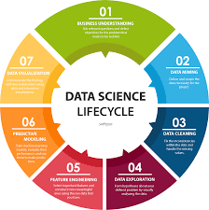
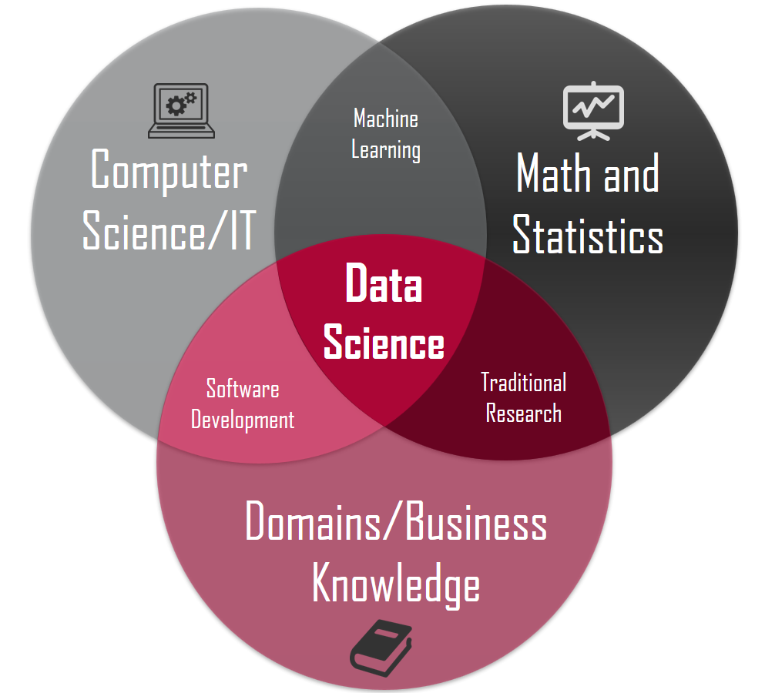
Introduction
Definition: Data science is the interdisciplinary field that uses scientific methods, processes, algorithms, and systems to extract insights and knowledge from structured and unstructured data.
Scope: It encompasses a range of techniques such as statistics, machine learning, data analysis, and data visualization.

Slide 4
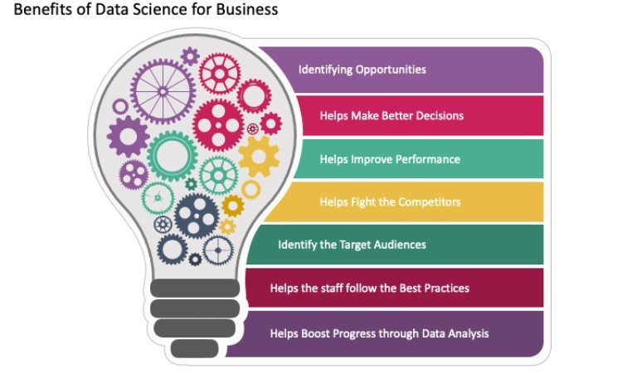
Benefits of Data Science
Informed Decision-Making
Predictive Analytics
Improved Efficiency
Personalization
Fraud Detection
Healthcare Advancements
Enhanced Customer Experience
Risk Management
Supply Chain Optimization
Human Resource Management

Slide 5
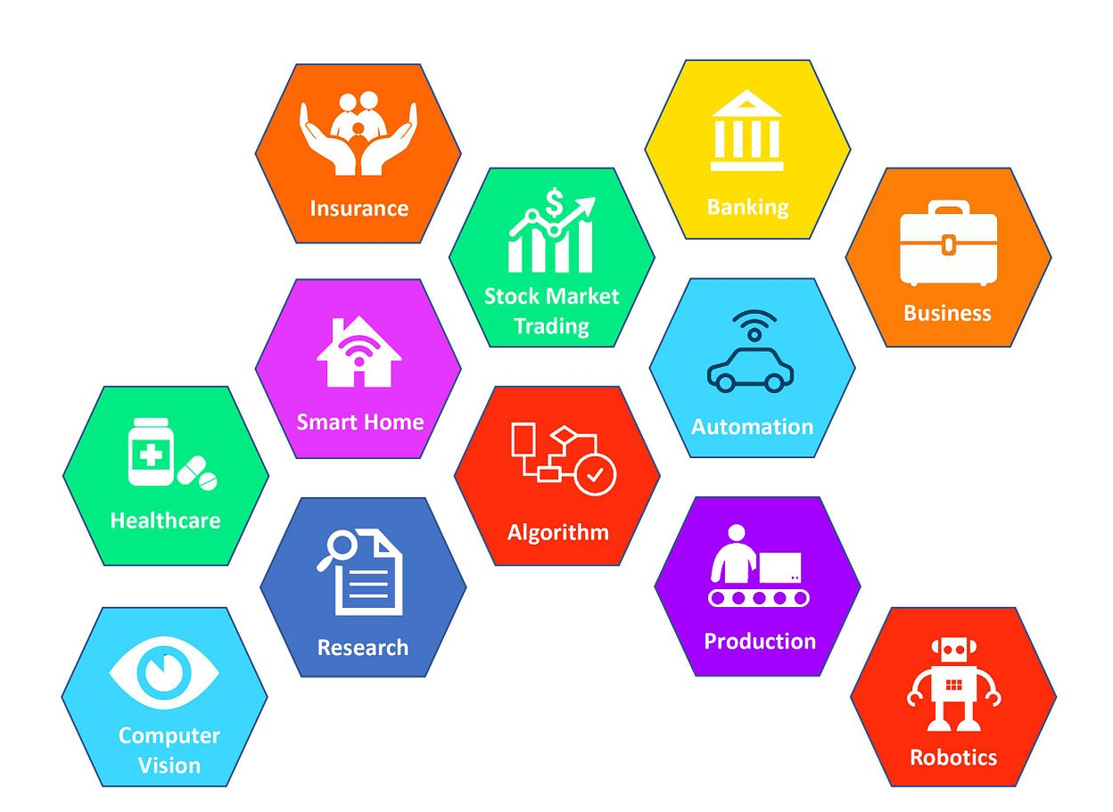
Industries Leveraging Data Science Skills
Finance and Banking
Healthcare
E-commerce
Telecommunications
Manufacturing
Retail
Marketing and Advertising

Slide 6
Industries Leveraging Data Science Skills
Energy and Utilities
Education
Government
Transportation and Logistics
Entertainment and Media

Slide 7
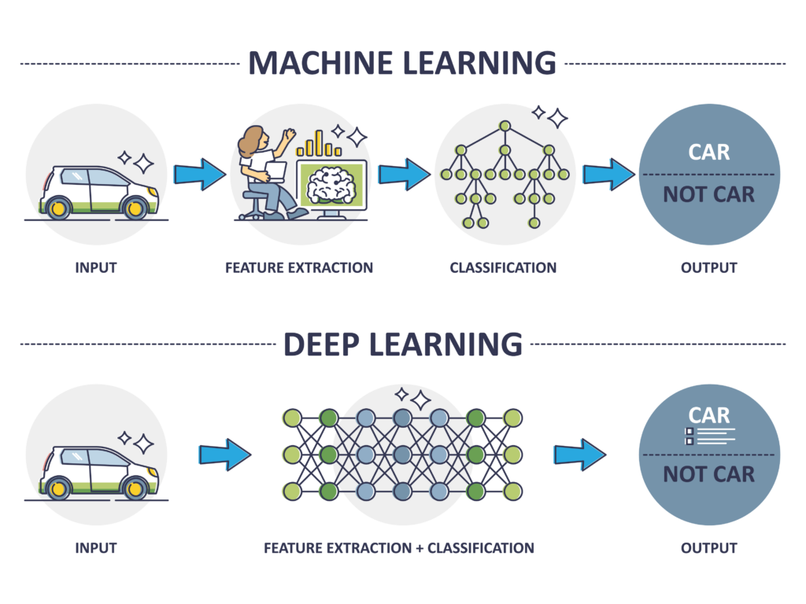
Specialized Areas Within Data Science
Machine Learning
Deep Learning
Natural Language Processing (NLP)
Computer Vision
Big Data Analytics
Time Series Analysis

Slide 8
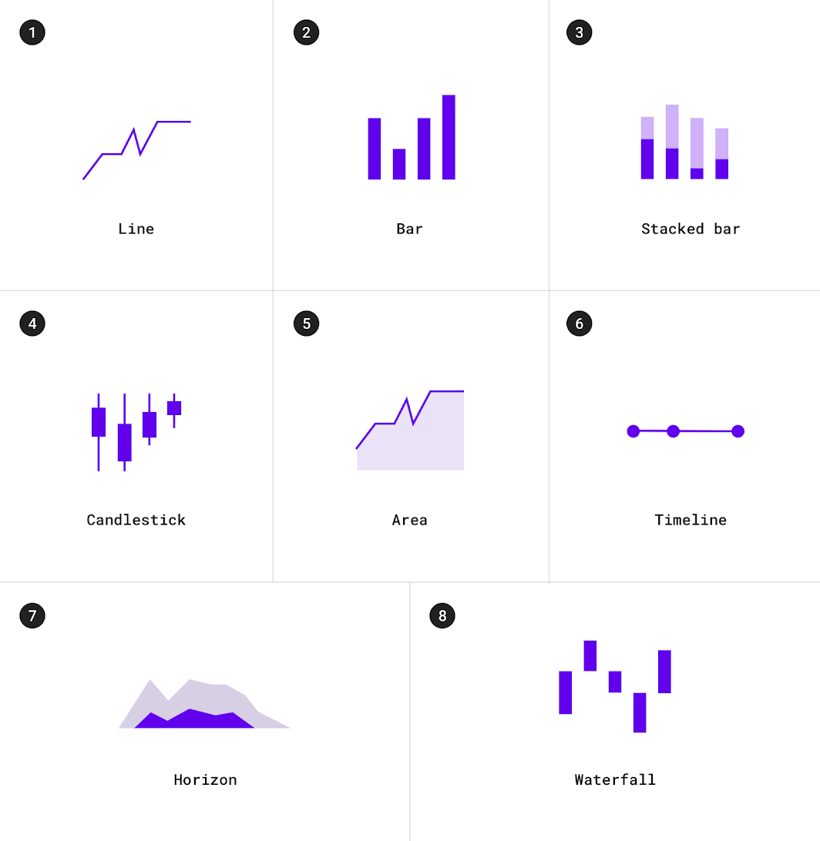
Specialized Areas Within Data Science
Spatial Data Analysis
A/B Testing
Data Engineering
Data Visualization
Quantitative Analytics
Ethics and Privacy in Data Science
Causal Inference

Slide 9


Tools in Data Science
Excel
Python
R
SQL
Jupyter Notebooks
Tableau

Slide 10
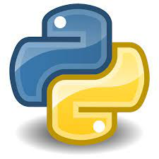


Tools in Data Science
TensorFlow
PyTorch
Pandas
NumPy
SciPy
MatplotLib

Slide 11
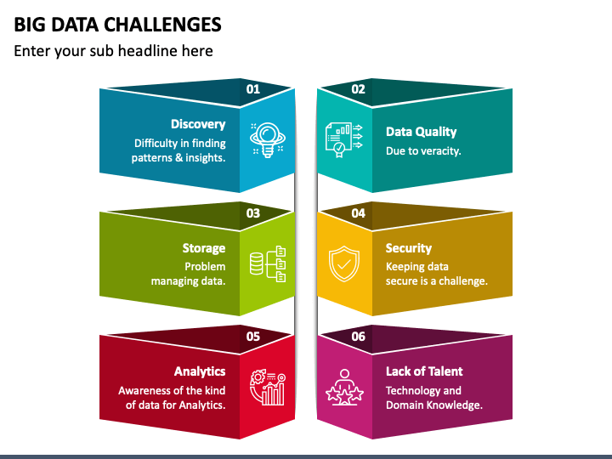
Challenges in Implementing Data Science
Data Quality and Integration
Talent Shortage
Ethical Considerations

Slide 12
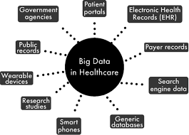
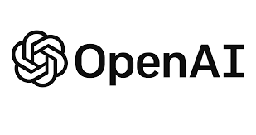
Conclusion and Future Trends
Future Trends in Data Science e.g Chat GPT
The Importance of Continuous Learning

Slide 13
Resources
Recommended Books
1. Python Data Science Handbook by Jake VanderPlas 2016 edition
Online Courses
1. Great Learning
2. Li - Academy
3. Course Era
Platforms to use
1. Google Colab
2. Kaggle.com for datasets
3. Github

